Slide 1
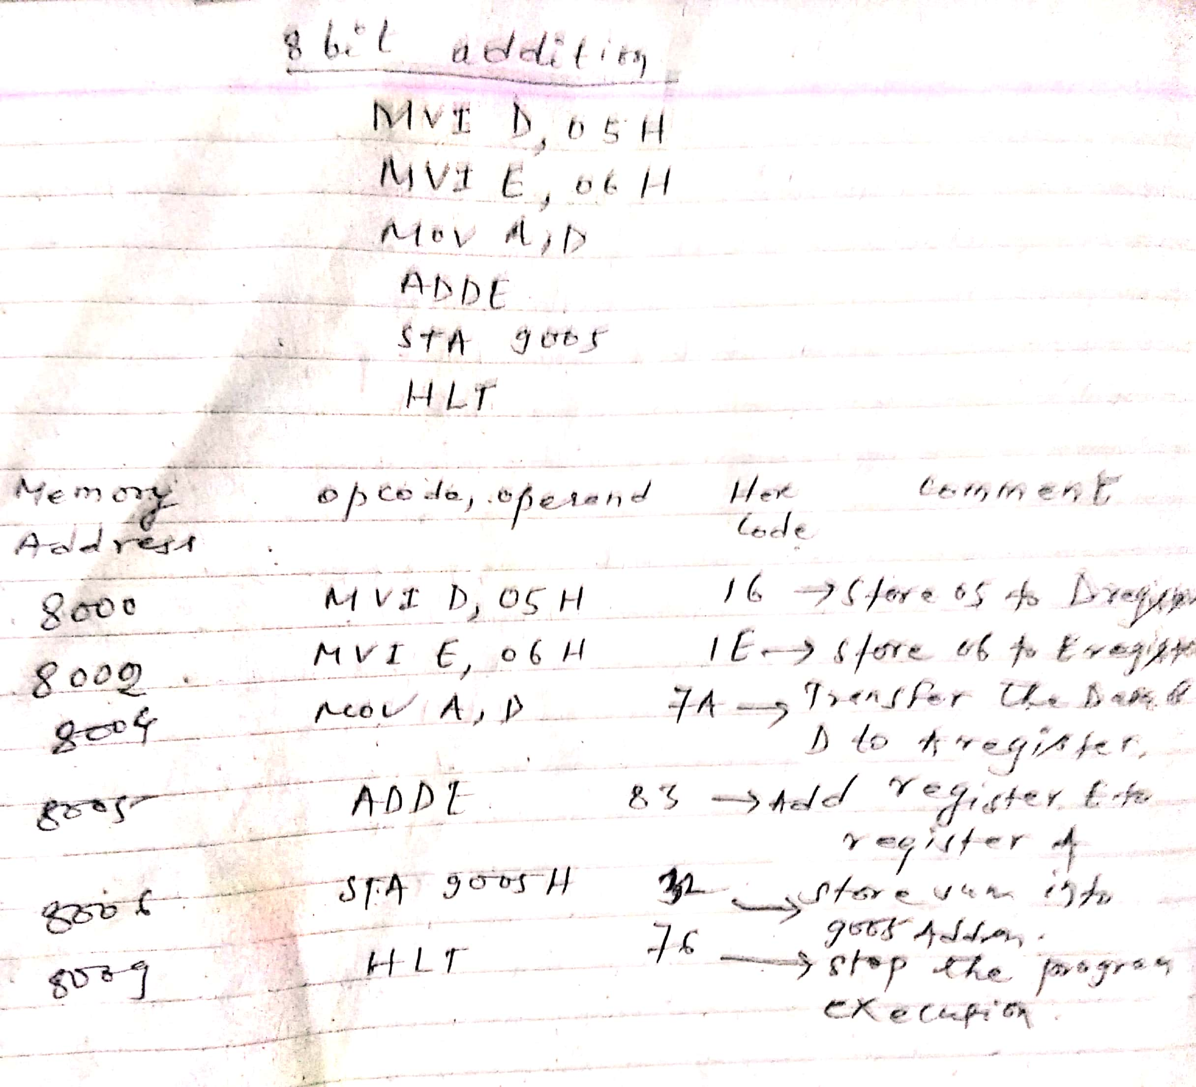
Microprocessor Program

Slide 2
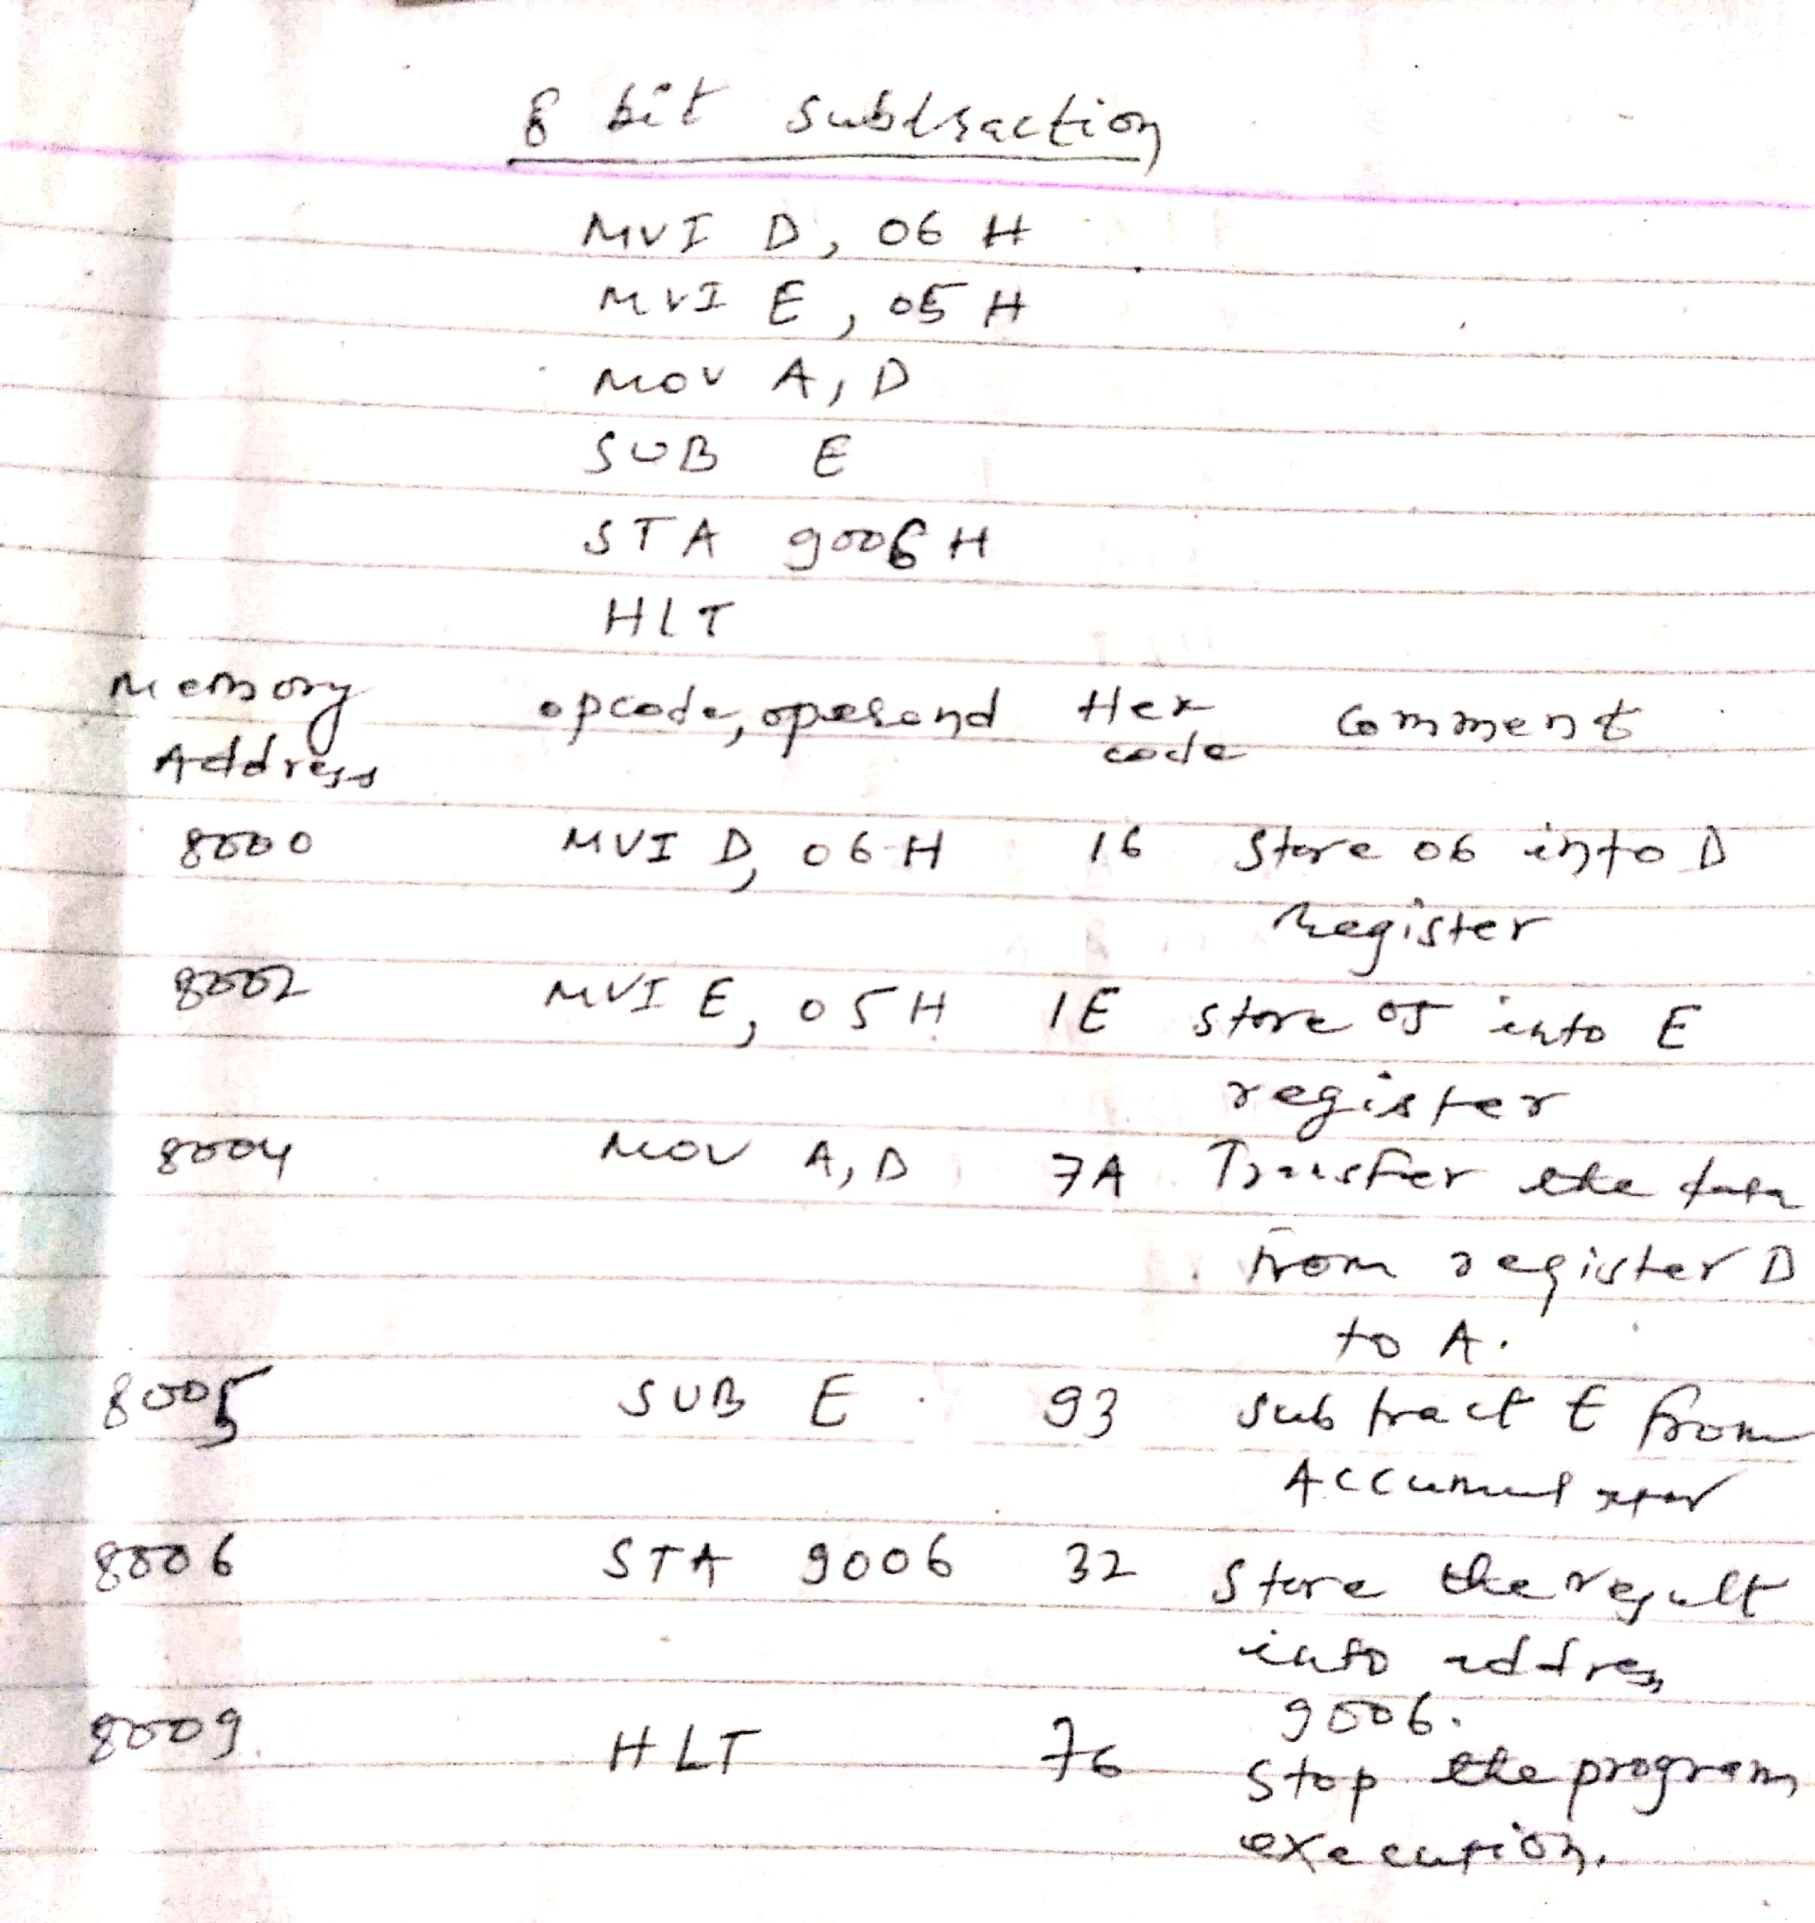
Microprocessor Program

Slide 3
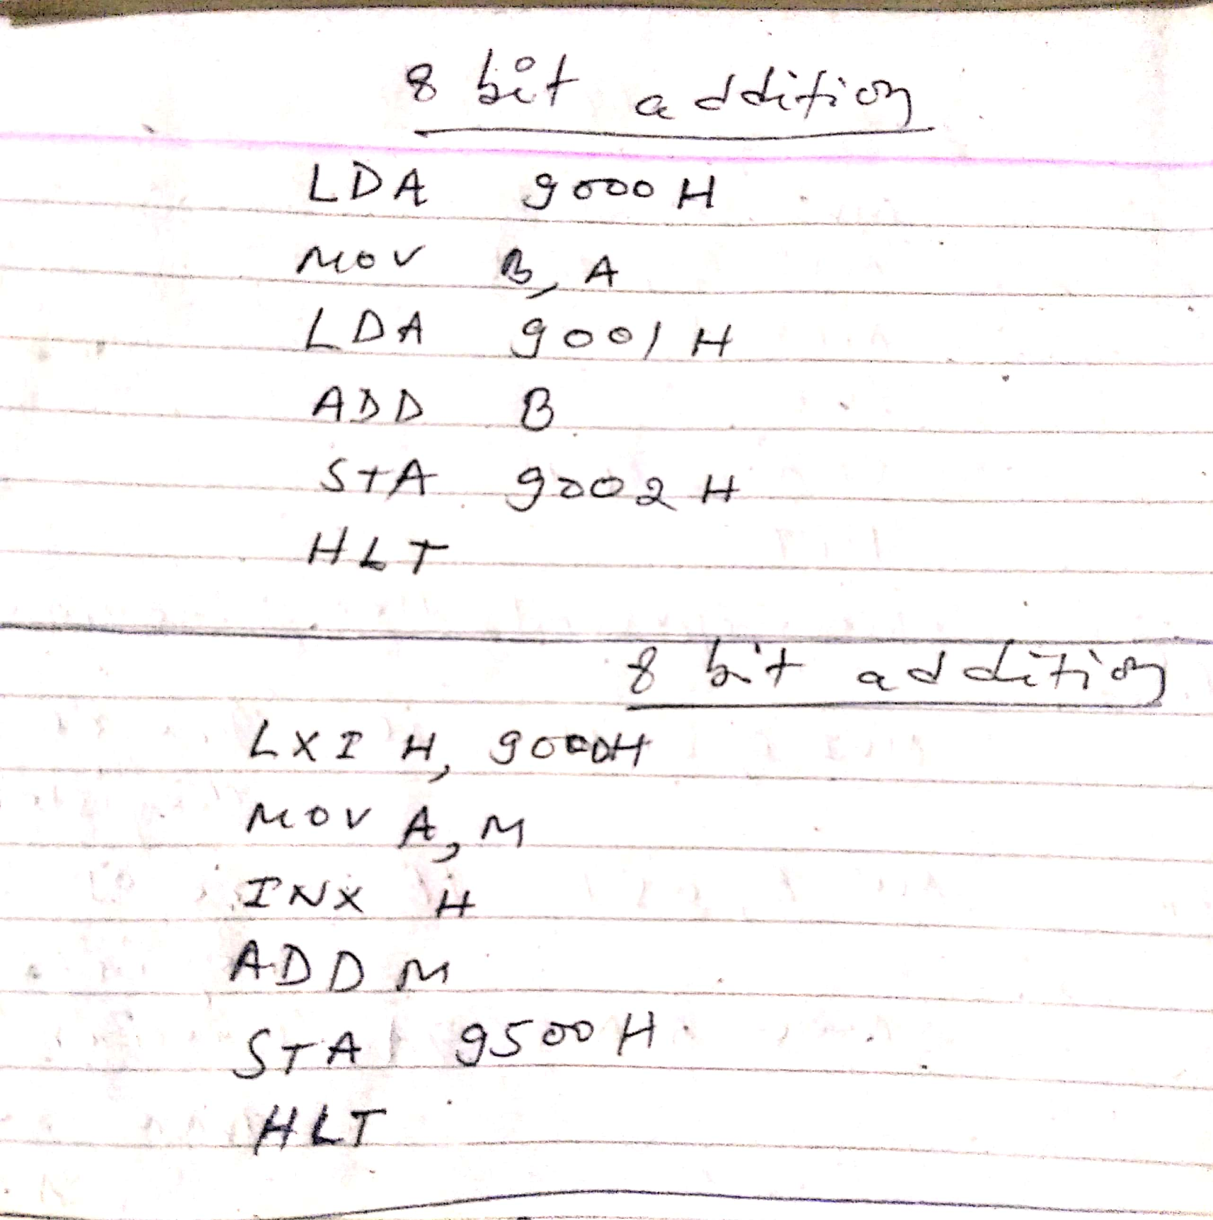
Microprocessor Program

Slide 4
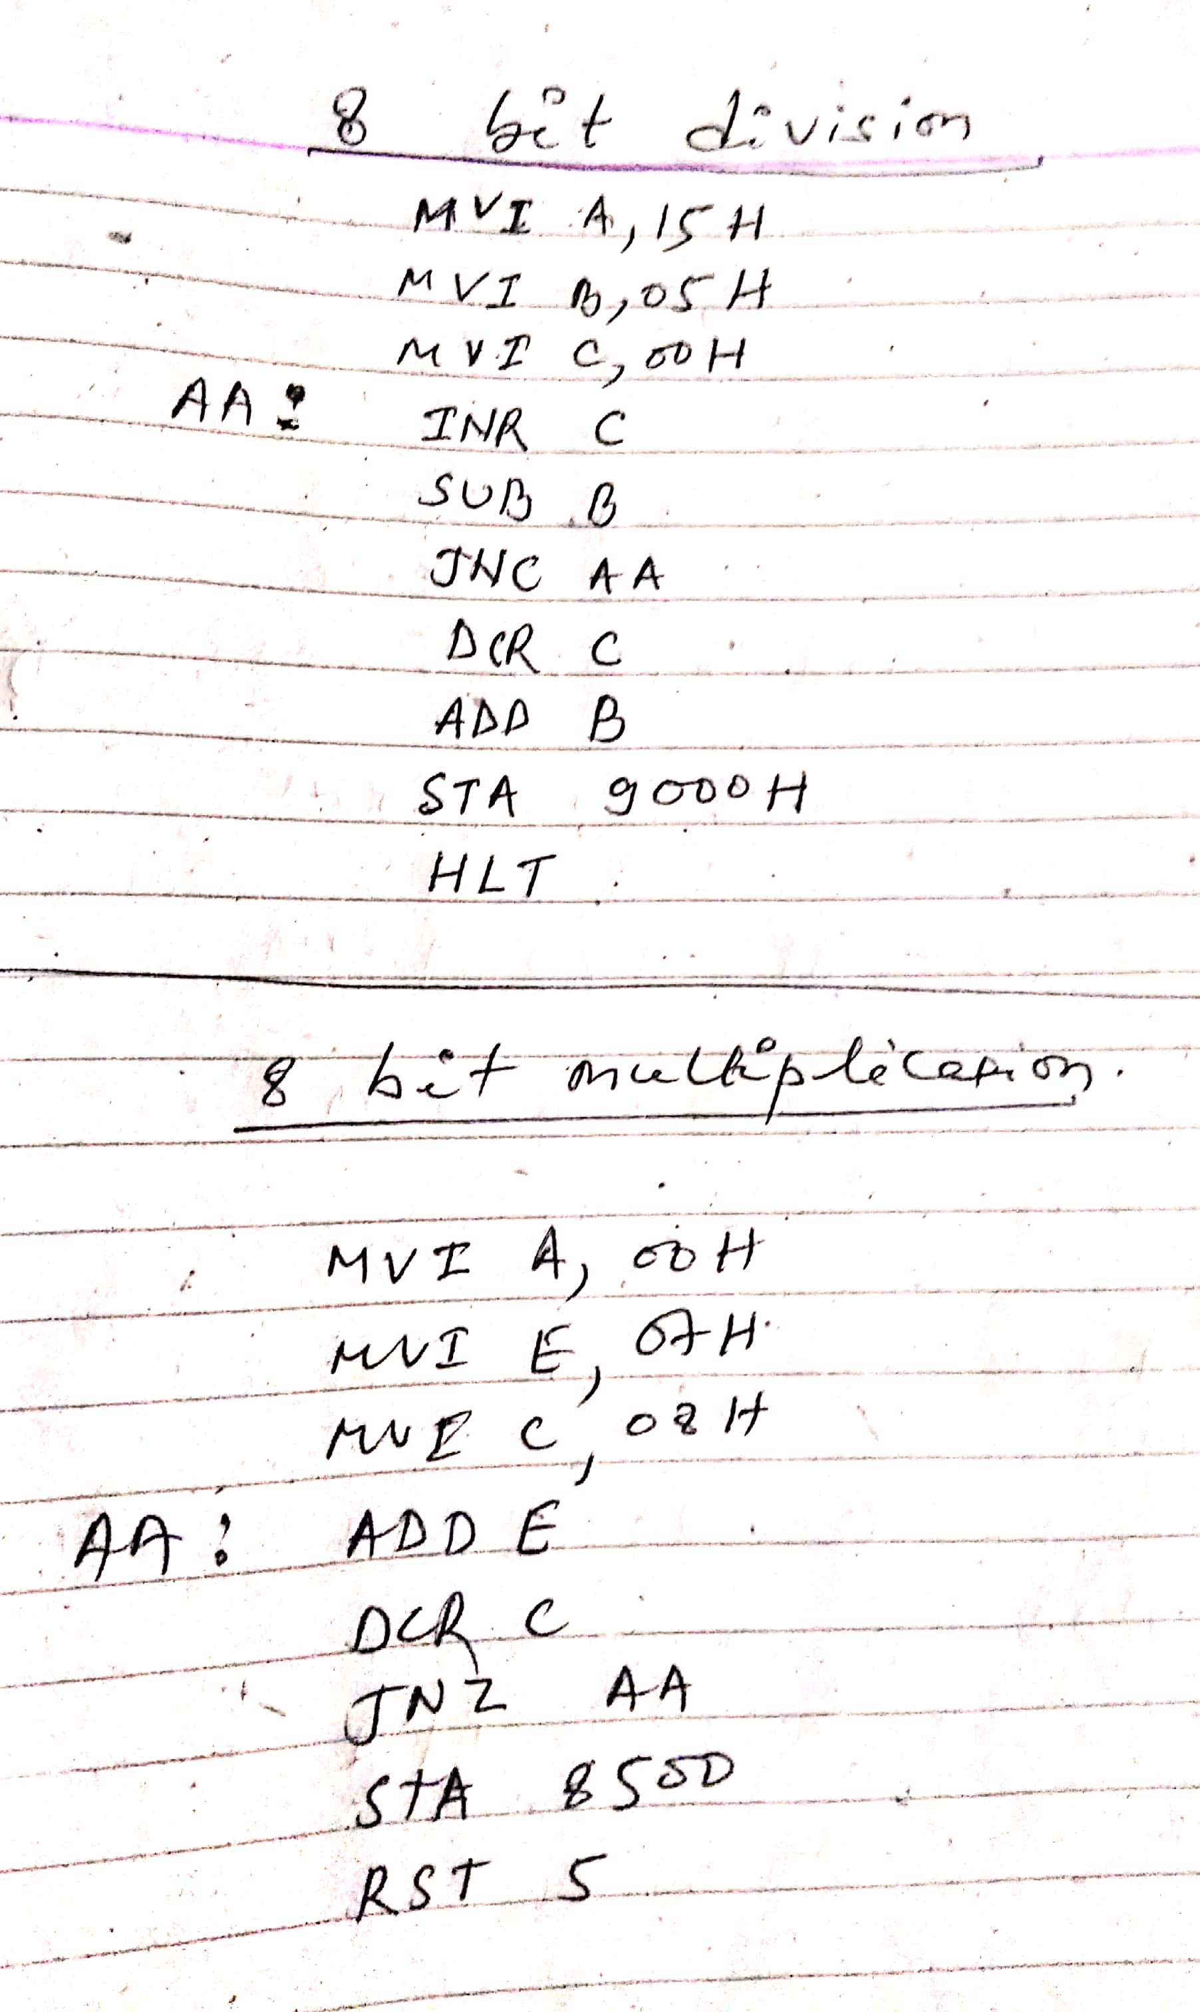
Microprocessor Program

Slide 5
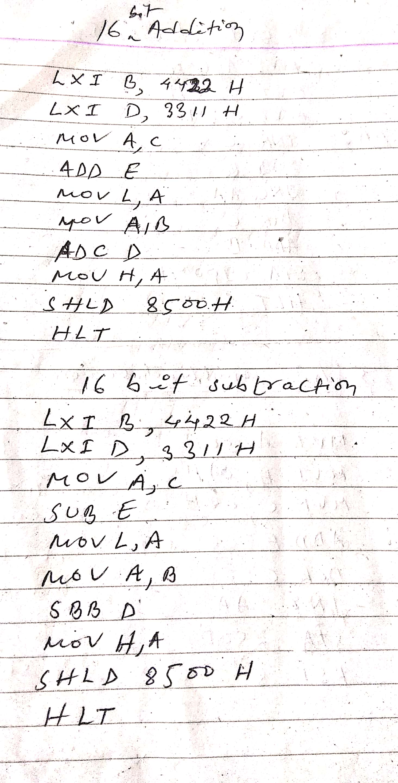
Microprocessor Program

Slide 6
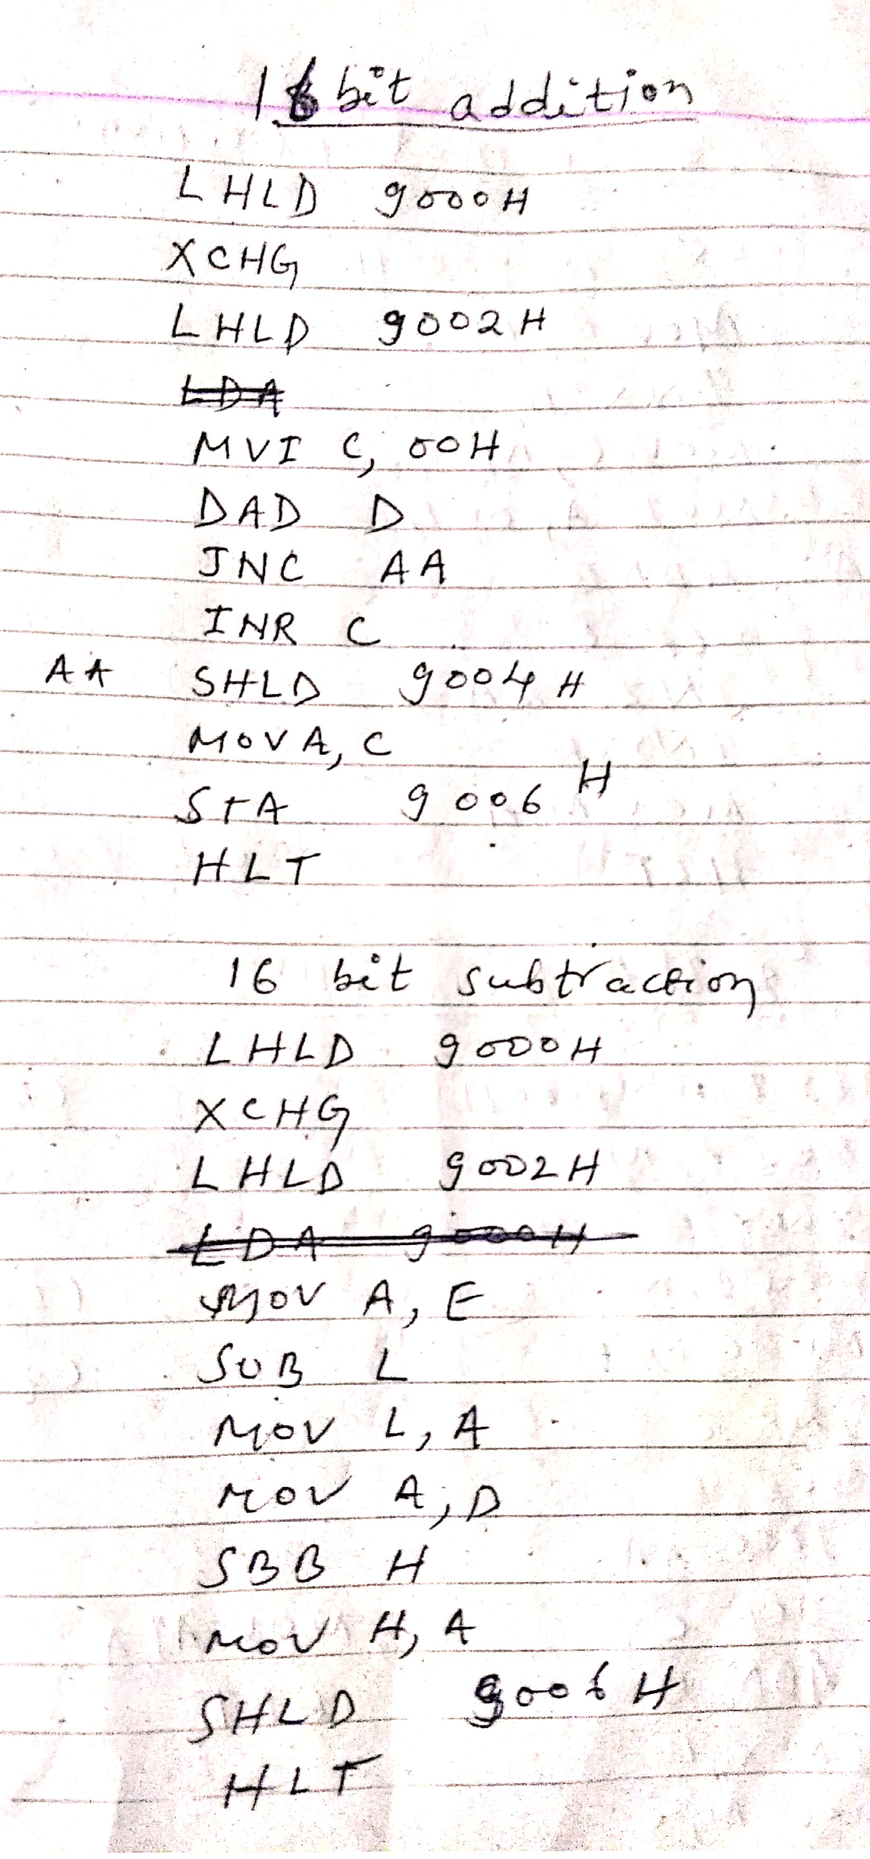
Microprocessor Program

Slide 7
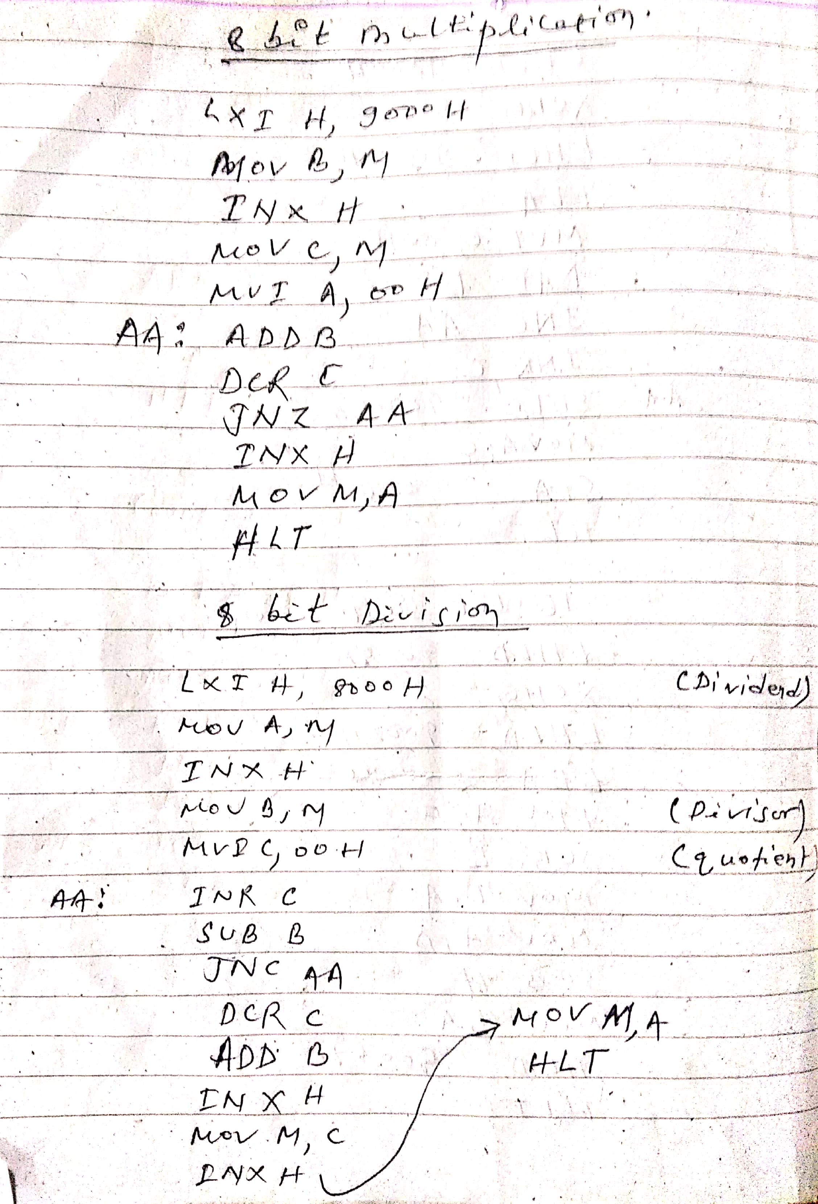
Microprocessor Program

Slide 8
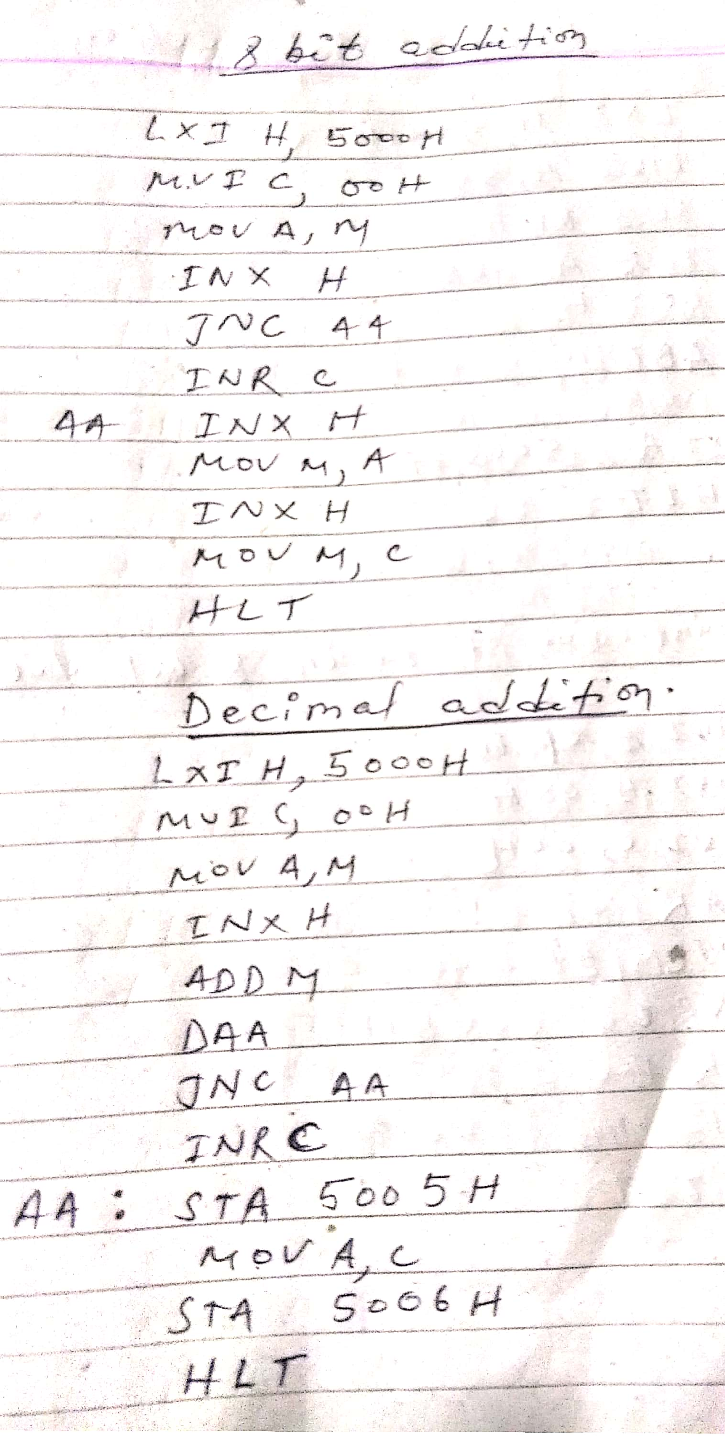
Microprocessor Program

Slide 9
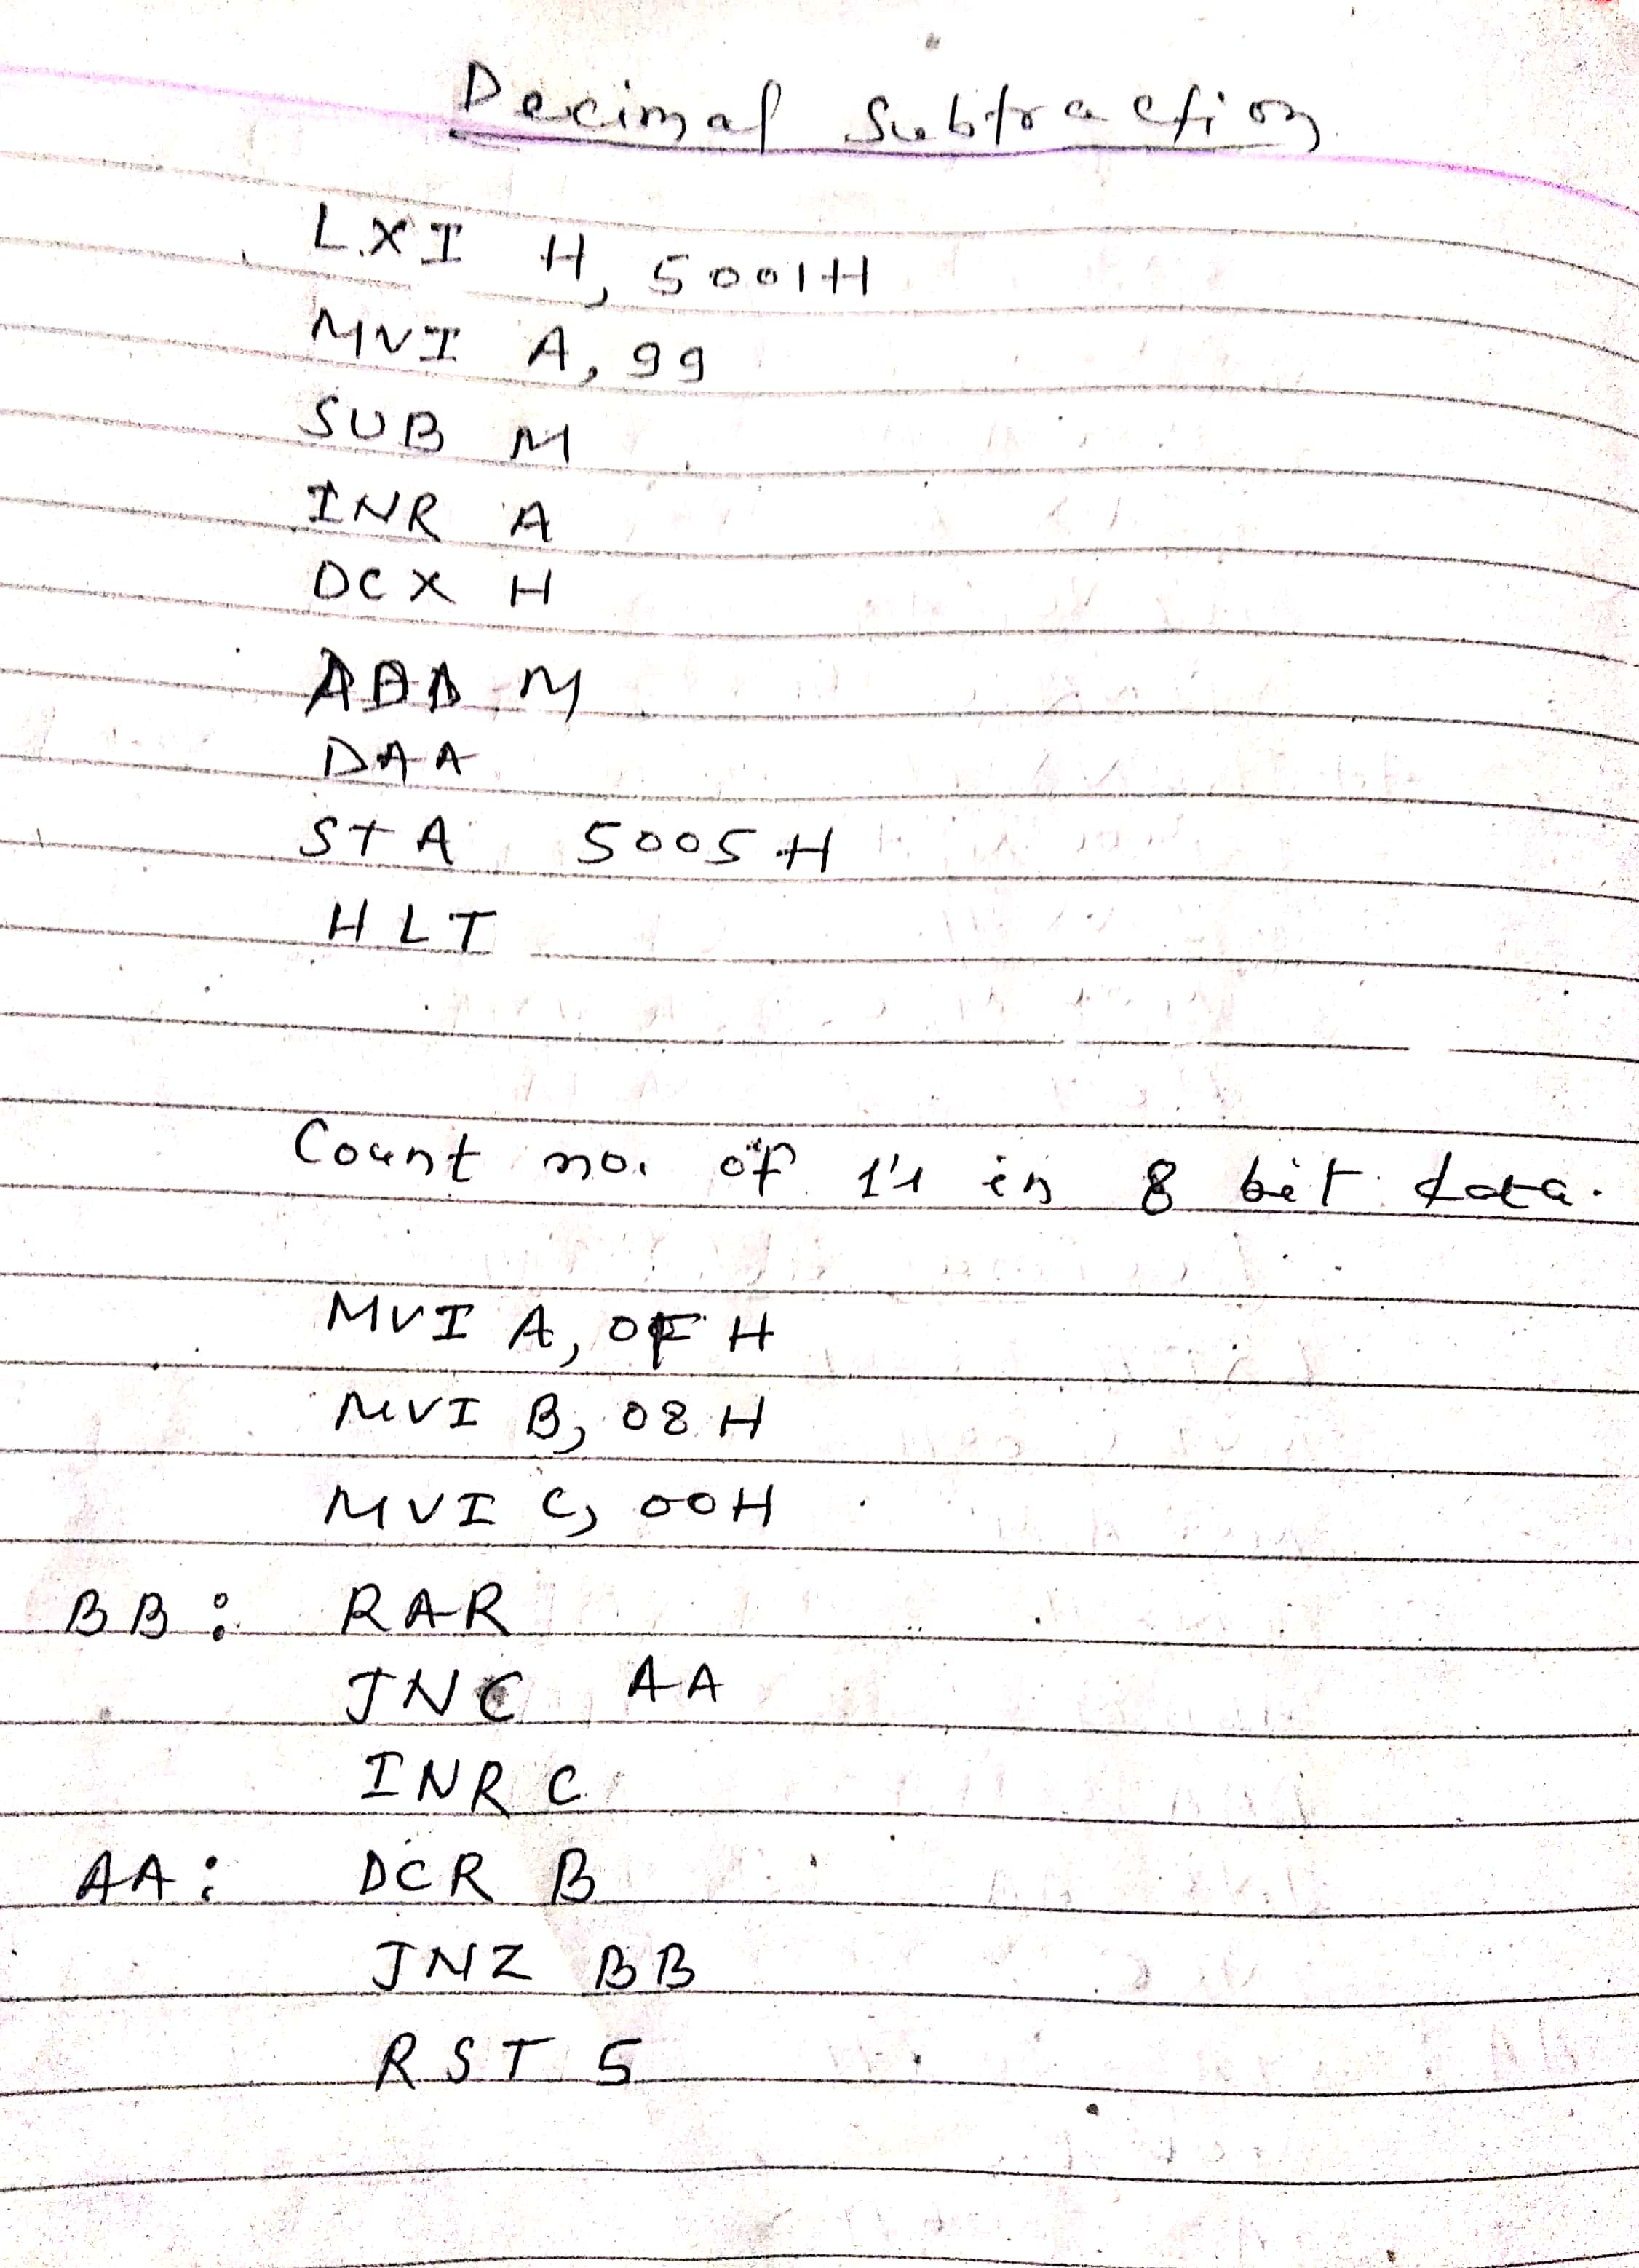
Microprocessor Program

Slide 10
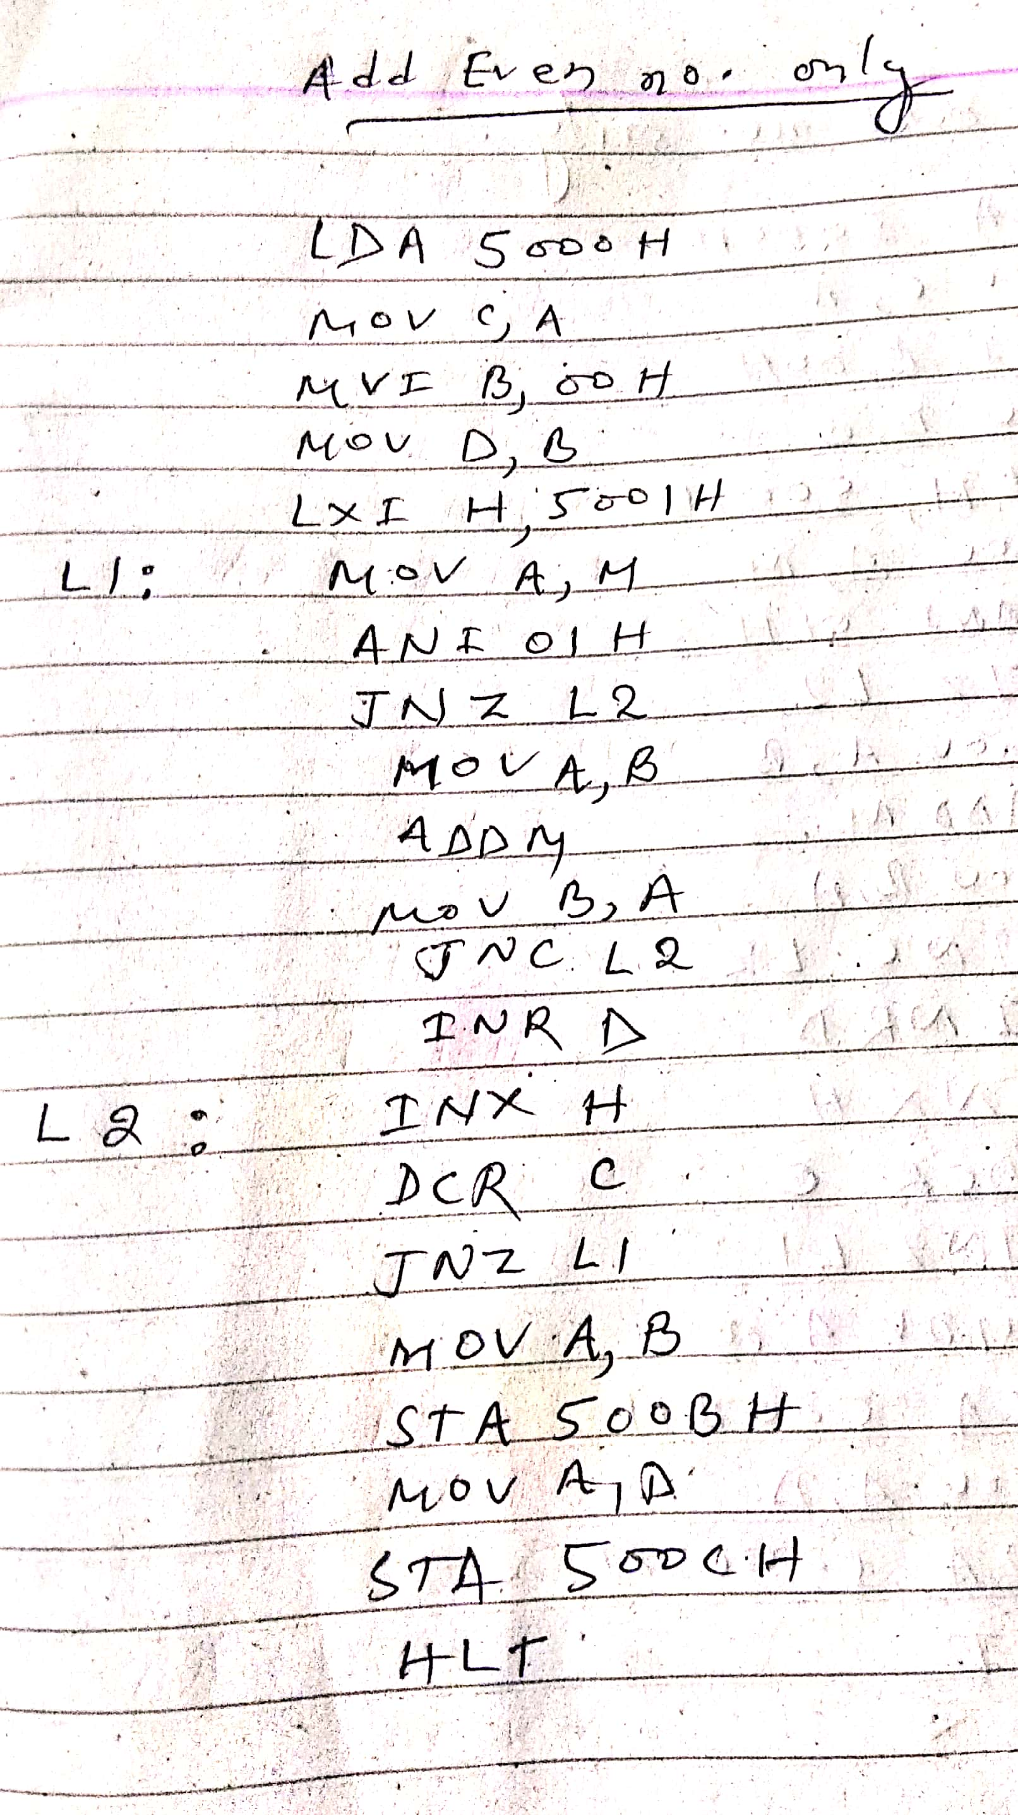
Microprocessor Program

Slide 11
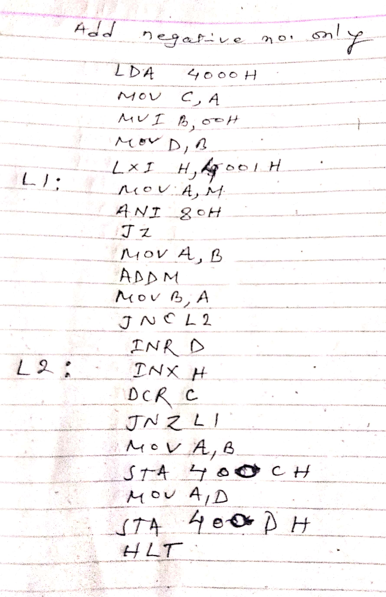
Microprocessor Program

